Slide 1
Factory Method
Design Pattern
Chris Drew 16th July 2014

Slide 2
Outline
Intro to PizzaStore with simple static factory
Live demo introducing factory method pattern
Look at the definition of factory method pattern
Applicability
Pros and cons
Differences vs Abstract Factory pattern

Slide 3
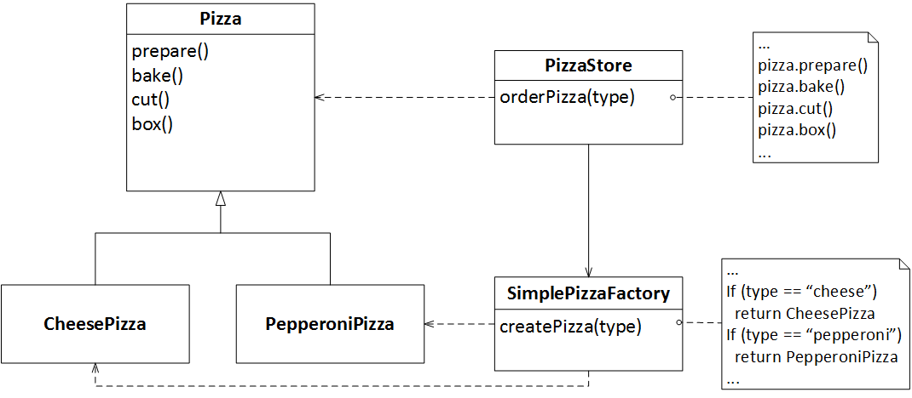
PizzaStore
Notes:
SimplePizzaFactory could have many clients, e.g PizzaStoreMenu
createPizza could be a static method

Slide 4
Demo

Slide 5
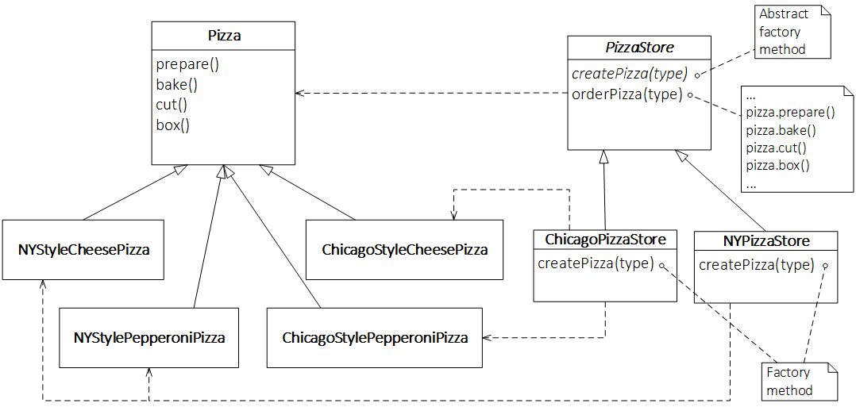
Factory Method Pattern - Example

Slide 6
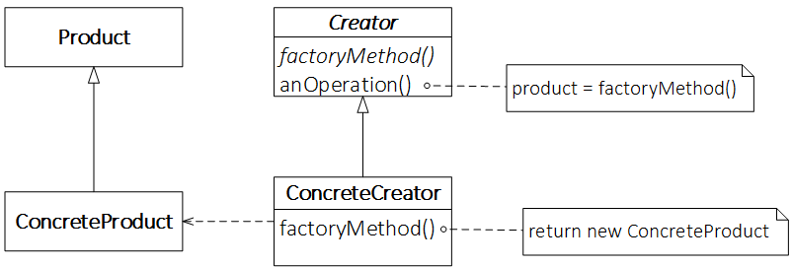
Factory Method Pattern - Defined
Defines an interface for creating an object, but lets subclasses decide which class to instantiate. Factory Method lets a class defer instantiation to subclasses.

Slide 7
Applicability
A class can’t anticipate the class of objects it must create.
A class wants its subclasses to specify the objects it creates.

Slide 8
Pros and Cons
TODO

Slide 9
Differences vs Abstract Factory Pattern
TODO Class vs Object
TODO Pattern is only one method rather than whole

Slide 10
References & Links
Head First Design Patterns
Design Patterns
https://github.com/crsdrw/patterns/tree/factory_method

